Slide 1
Generalized Linear Models

Slide 2
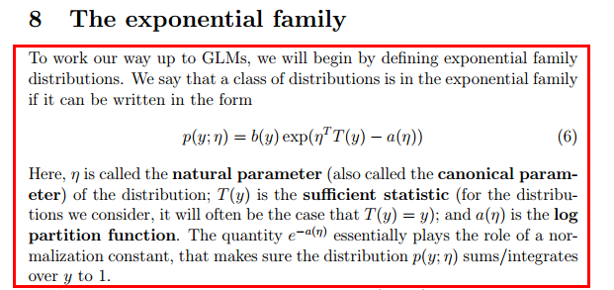

Slide 3
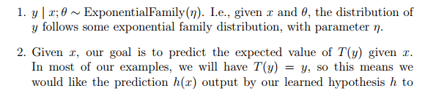
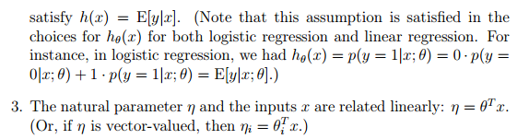
Constructing GLMs

Slide 4

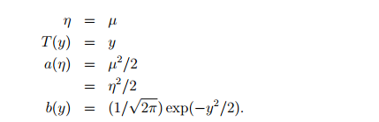
Ordinary Least Squares

Slide 5
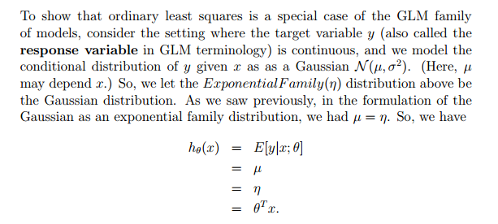

Slide 6
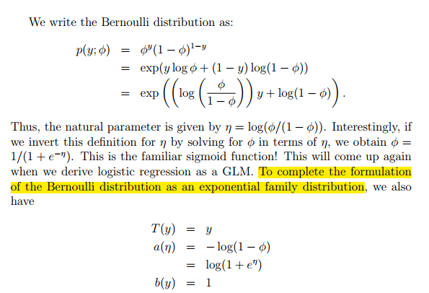
Logistic Regression

Slide 7
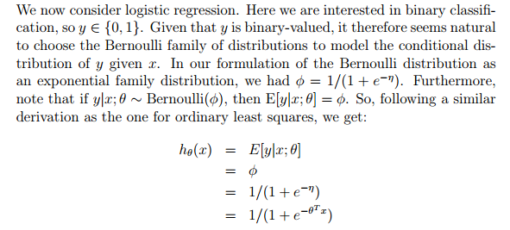

Slide 8
Softmax Regression
Consider a classification problem in which the response variable y can take on any one of k values, so y ∈{1 2, . . . , k}.
Lets derive a GLM for modelling this type of multinomial data. To do so, we will begin by expressing the multinomial as an exponential family distribution.

Slide 9
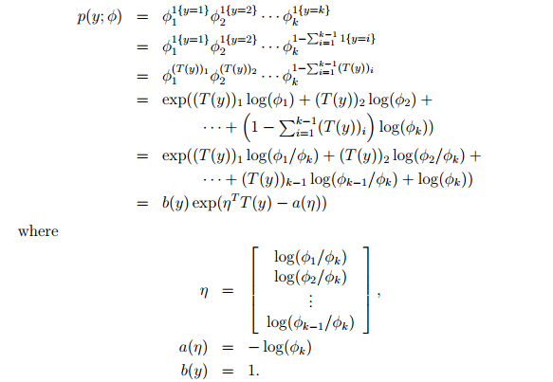

Slide 10
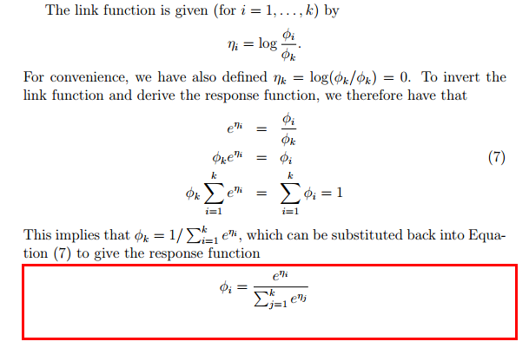

Slide 11
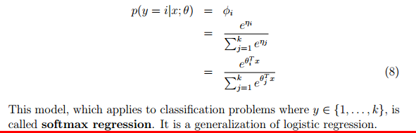

Slide 12
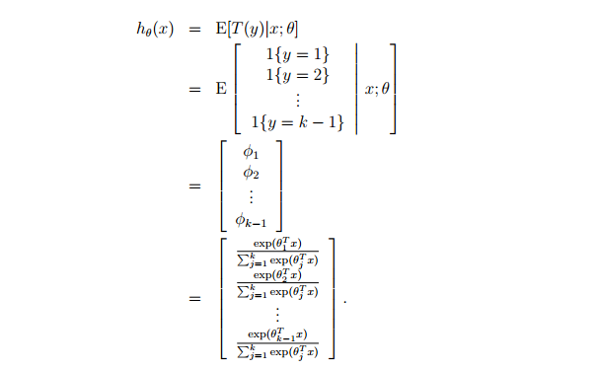

Slide 13
